Slide 1
Reference Model Metrics v1.0 - Scope, Definitions & User Guide

Slide 2
Agile
S. No | Metrics | Description | KPI | Traceability Number | Source
1 | Velocity (Scope Variance) | Committed Story Points Completed / Story Points Committed (Scope Variance) | Agile | METRIC20 | Jira
2 | Release Burn down | Planned velocity is the velocity assumed to plan the release. This could be based on an average of velocity achieved in past sprints or an assumed velocity to start with. The average could be calculated in different variations – see formula Optimistic velocity – is a planned velocity but considers the best case situation Pessimistic Velocity – is a planned velocity but considers the worst case situation | Agile | METRIC32 | Jira
3 | Project Burn down | At Project level with Optimistic / Pessimistic release burn down chart (custom-built) in JIRA Story Points - Burn down Chart | Agile | METRIC32 | Jira
http://wiki.hq.dt.inc/display/DevProc/DT+Reference+Model+-+Metrics+Gadgets+-+Overview

Slide 3
Quality \ Effectiveness
S. No | Metrics | Description | KPI | Traceability Number | Source
4 | # Emergency tickets | # valid emergency production defect. Release Tickets which are tagged as Emergency | Quality | METRIC3 | Jira
5 | Defect Distribution Cause-wise ; Severity-wise . Cycle- wise ; Stage-wise . Pass-wise; Resource-wise | Refer to Mockups screen | Quality | METRIC36 | Jira
6 | Project DLR | # valid production defects / (# valid QA defects + # valid production defects) | Quality | METRIC1 | Jira
7 | Defect Density (Agile) * (Open Discussion item – Refer Slide) | # of Valid Defects / # Development Story Points delivered Assumption: The data will be valid on the report only when each Defect is linked to one more Stories (This needs some more discussion) | Quality | METRIC7 | Jira
8 | Defect Density | # of Valid Defects / # Normalized tickets delivered (# of Normalized tickets = # Story + # Technical Story + # Requirements) | Quality | METRIC8 | Jira
9 | First Time Fix | # of QA defects reworked / # of QA defects logged and closed | Effectiveness | METRIC10 | Jira
10 | Defect Turn Around Time | Defect Close Date - Defect Detection Date | Quality | METRIC34 | Jira
11 | # of Critical and High Defects | # valid Critical and High production defect | Quality | METRIC4 | Jira
12 | Defect Acceptance Ratio | # of valid QA defects / Total # of QA defects | Quality | METRIC9 | Jira
13 | Open Defects | # of Open defects | Quality | METRIC33 | Jira
14 | Planned v/s Actual (Same as Velocity) | Planned Development Tickets v/s Actual Completed Tickets Complete Tickets, Tickets moved to QA | Quality | METRIC31 | Jira
15 | Test Execution Progress | Also called as Test Case Execution Status – In Qmetry | Quality | METRIC35 | QMetry
16 | Test Case Execution Status | No of test cases passed / Total test cases executed | Quality | METRIC5 | QMetry
http://wiki.hq.dt.inc/display/DevProc/DT+Reference+Model+-+Metrics+Gadgets+-+Overview

Slide 4
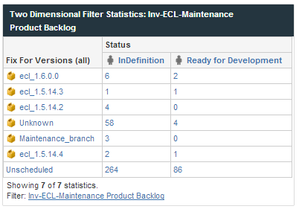
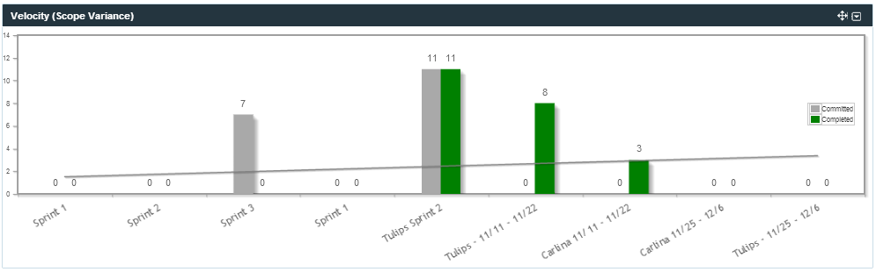
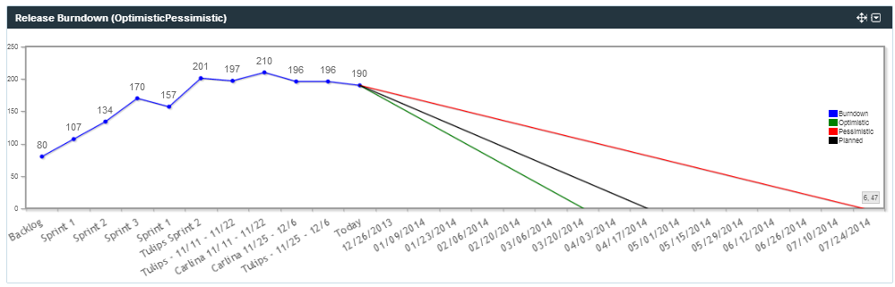
Standard Metrics - Agile
Release Burn down
Velocity
Product Backlog Status

Slide 5
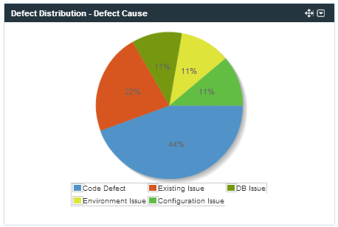
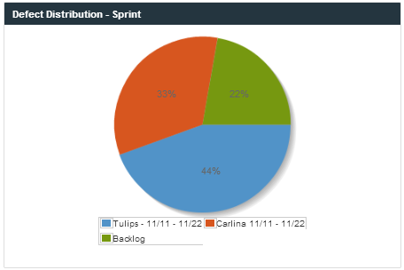
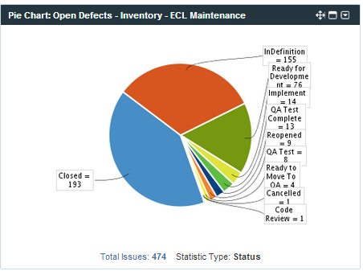
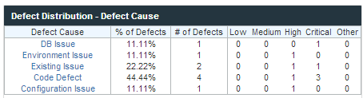
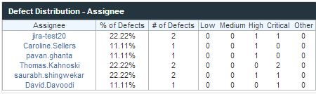

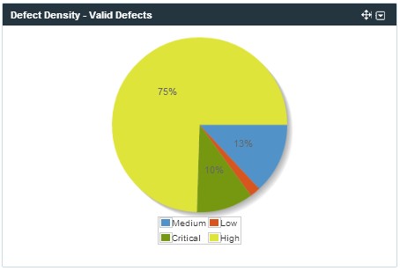
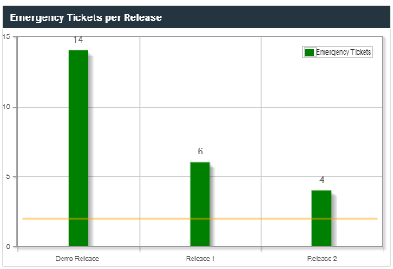
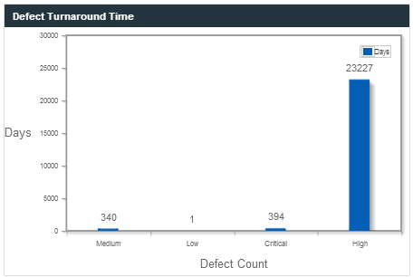
Standard Metrics - Quality
Defect Distribution (Cause Wise,
Assignee & Sprints)
> Open Defects
> DAR
> Defect Density
> Defect Turnaround Time
Emergency Defects per
Release

Slide 6
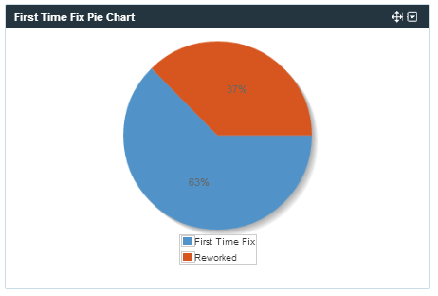
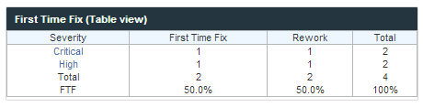
Standard Metrics - Effectiveness
First Time Fix
Tabular
Pie Chart

Slide 7
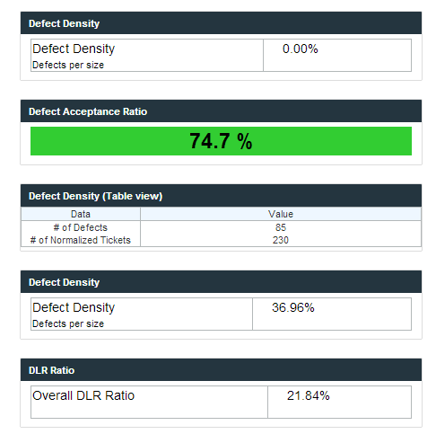
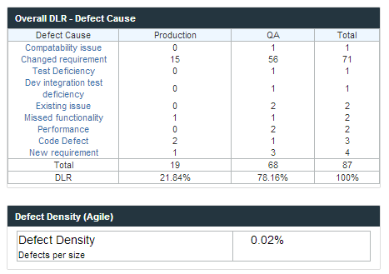
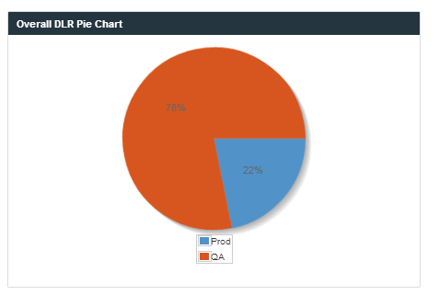
Standard Metrics - Quality

Slide 8
New Scope Items (Parking Lot)
S. No | Source | Metrics | Description | Source
1 | Identified as part of 10/2 Review | Backlog Cumulative Flow(CFD) (Priority A) | A Cumulative Chart that provides the break up of the Backlogs in terms of status mentioned below over a time period In Definition ready For Development In Progress & Dev Complete QA Testing & QA Complete Closed Filter Criteria : Start Date & End Date. Flexibility to provide the interval for plotting the graph on the x-axis Note : X – Axis to plot the Interval between start date and end date. | Jira
2 | Identified as part of 10/2 Review | Backlog Composition (Priority B) | A break up of the backlog in terms of various issue types (Story, Tech Story, Defect, Requirement, Technical Debt) Filter Criteria : Start Date & End Date. Flexibility to provide the interval for plotting the graph on the x-axis Note : X – Axis to plot the Interval between start date and end date | Jira
3 | Identified as part of 10/2 Review | Predictive Backlog Burn down (Needs Discussion) | A predictive chart of Backlog burn down based on available team(s) capacity. This helps in identifying schedule ,resource and planning based on a baseline Goal Note : (Need more discussions) You can get from Release burn down itself | Jira
4 | Identified as part of 10/2 Review | Backlog Maturity - Elaboration (Priority B) | Describes the granularity of the Issues in the backlog, which is an indicator if the stories are sufficiently elaborated or not. Depicted as a Distribution of Issue based on Story Point Range (Size) (1-5, 6-10,11-15,16-20,21-50) On a given date (today) no filter criteria. As of today what is the backlog maturity. Metrics will take today date and plot. One given date default to todays date. | Jira
5 | Identified as part of 10/2 Review | Team wise productivity (Needs Discussion) | Productivity of team(s) over a period of time. A project could have multiple teams and this metric will show team wise a trend of productivity (Need more discussions) | Jira -As a part of Dashboard
6 | Identified as part of 10/2 Review | Velocity Tabular View (Scope Variance) (Priority A) | Sprint Name Committed Story Points . Completed Story Points Total Committed . Total Completed Average Committed Average Completed Velocity\Week | Jira

Slide 9
New Scope Items (Parking Lot)
S. No | Source | Metrics | Description | Source
7 | Feedback from Adeliya | Defect Backlog over a Sprint\Release (Needs Discussion) | Resolution : Add Story Points\ROM estimation fields on defect screen. Once done it will automatically account for defects in Release & Project Burn down. | Jira
8 | % Business Value Delivered *Newly Added | This metric shows how much of the business value has been delivered for a Release | Discussions needed Note : Donal wanted Priority field to be used for release | Jira
9 | Feedback from Adeliya | Open Defects by Age, Range & Severity (Priority A) | Refer Slide 11 Age = Day when the defect was raise – day when the defect was closed | Jira
10 | Request From Rick | M&E Backlog (Priority A) | This is a measure of the M&E backlog for a product. Measures include: Number of tickets Total effort Man months

Slide 10
New backlog - Mockups (Actual look & Feel may vary slightly on the dashboard )

Slide 11
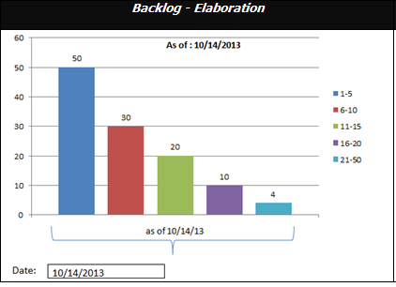
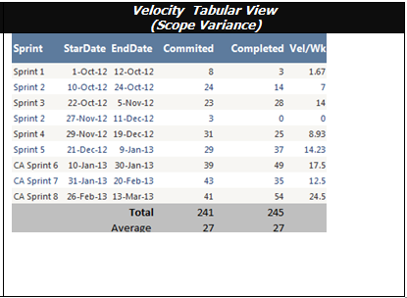
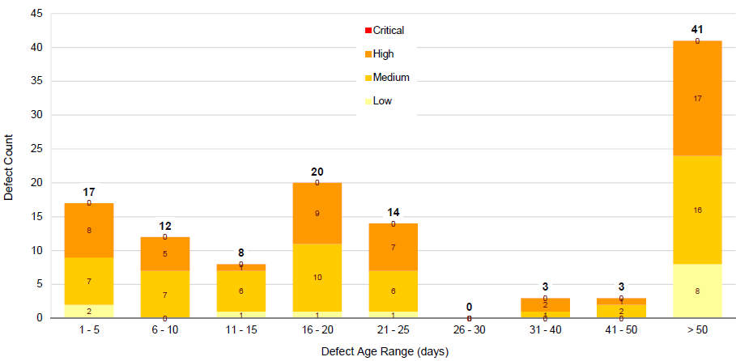
New backlog - Mockups (Actual look & Feel may vary slightly on the dashboard )
Open Defects by Age ,Range & Severity

Slide 12
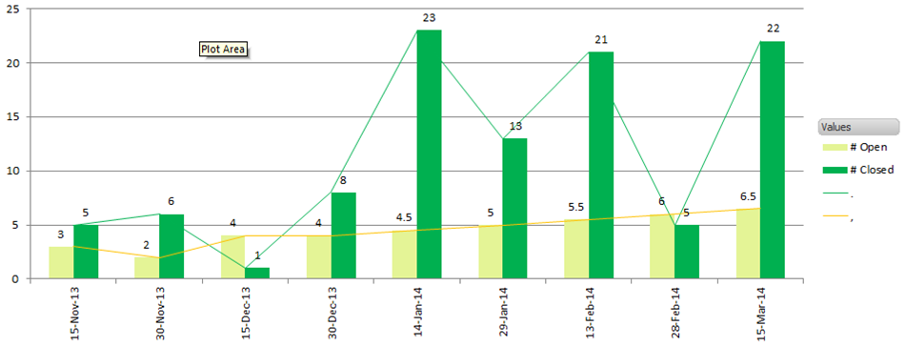
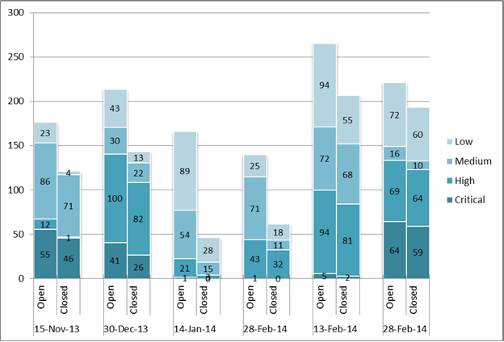
New backlog - Mockups (Actual look & Feel may vary slightly on the dashboard )
Mockup 1 (Open vs Closed defects based on a date range. We will provide option to specify the interval between the date range and also give an option to display the Month Only or Full Date on the horizontal axis)
Mockup 2 (Open vs Closed defects based on a date range. We will provide option to specify the interval between the date range and also give an option to display the Month Only or Full Date on the horizontal axis) This will have severity also shown in the stacked bar chart

Slide 13
Thank You

